Slide 1
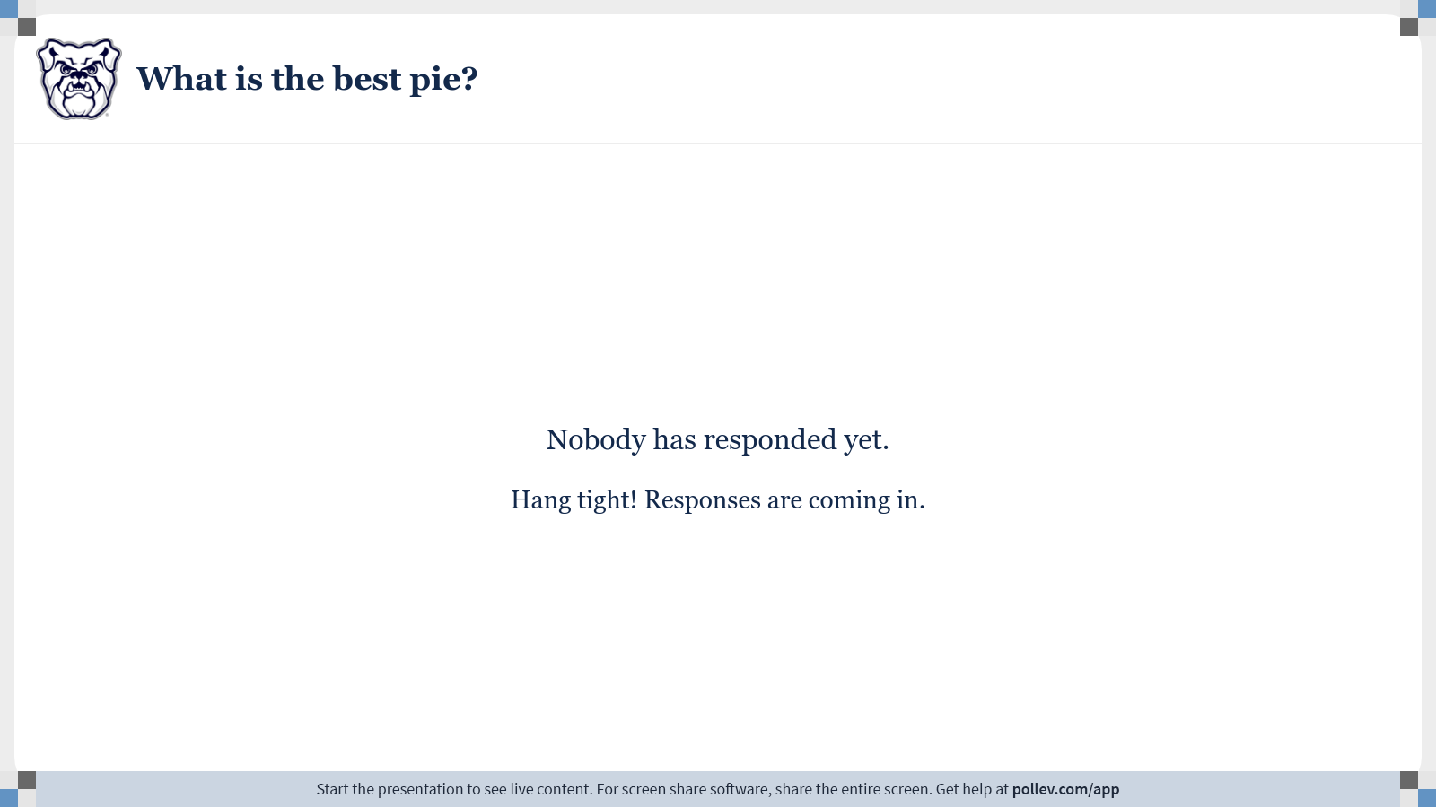
Notes:
Poll Title: Do not modify the notes in this section to avoid tampering with the Poll Everywhere activity. More info at polleverywhere.com/support What is the best pie? https://www.polleverywhere.com/free_text_polls/KgfhZQGdw3GVmqyWVZoxj

Slide 2
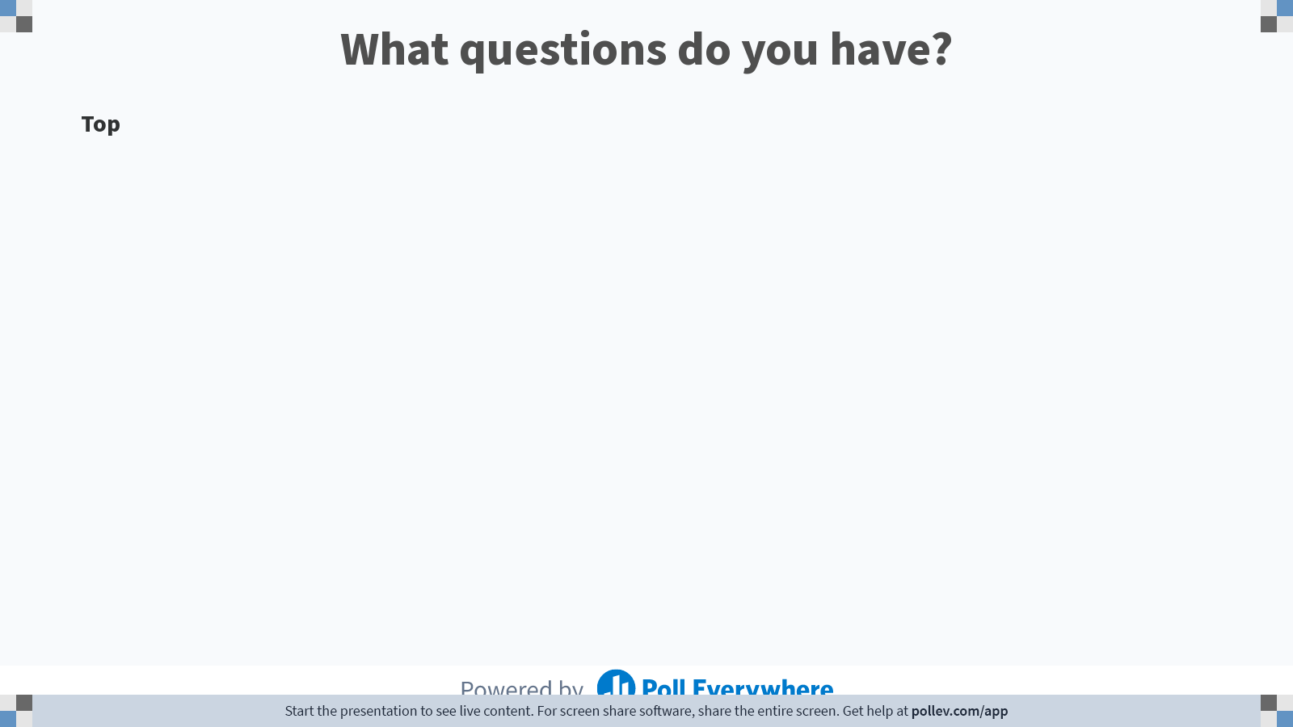
Notes:
Poll Title: Do not modify the notes in this section to avoid tampering with the Poll Everywhere activity. More info at polleverywhere.com/support What questions do you have? https://www.polleverywhere.com/discourses/zzmuGUUeCW1bxjbj84Ydr

Slide 3
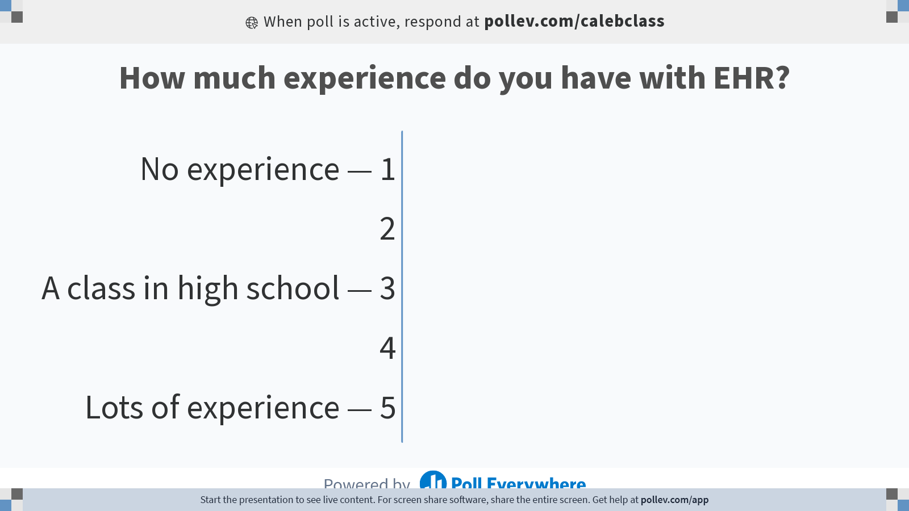
Notes:
Poll Title: Do not modify the notes in this section to avoid tampering with the Poll Everywhere activity. More info at polleverywhere.com/support How much experience do you have with EHR? https://www.polleverywhere.com/multiple_choice_polls/Tb1gsyxLF5esV1tPruBf6?state=opened&flow=Default&onscreen=persist

Slide 4
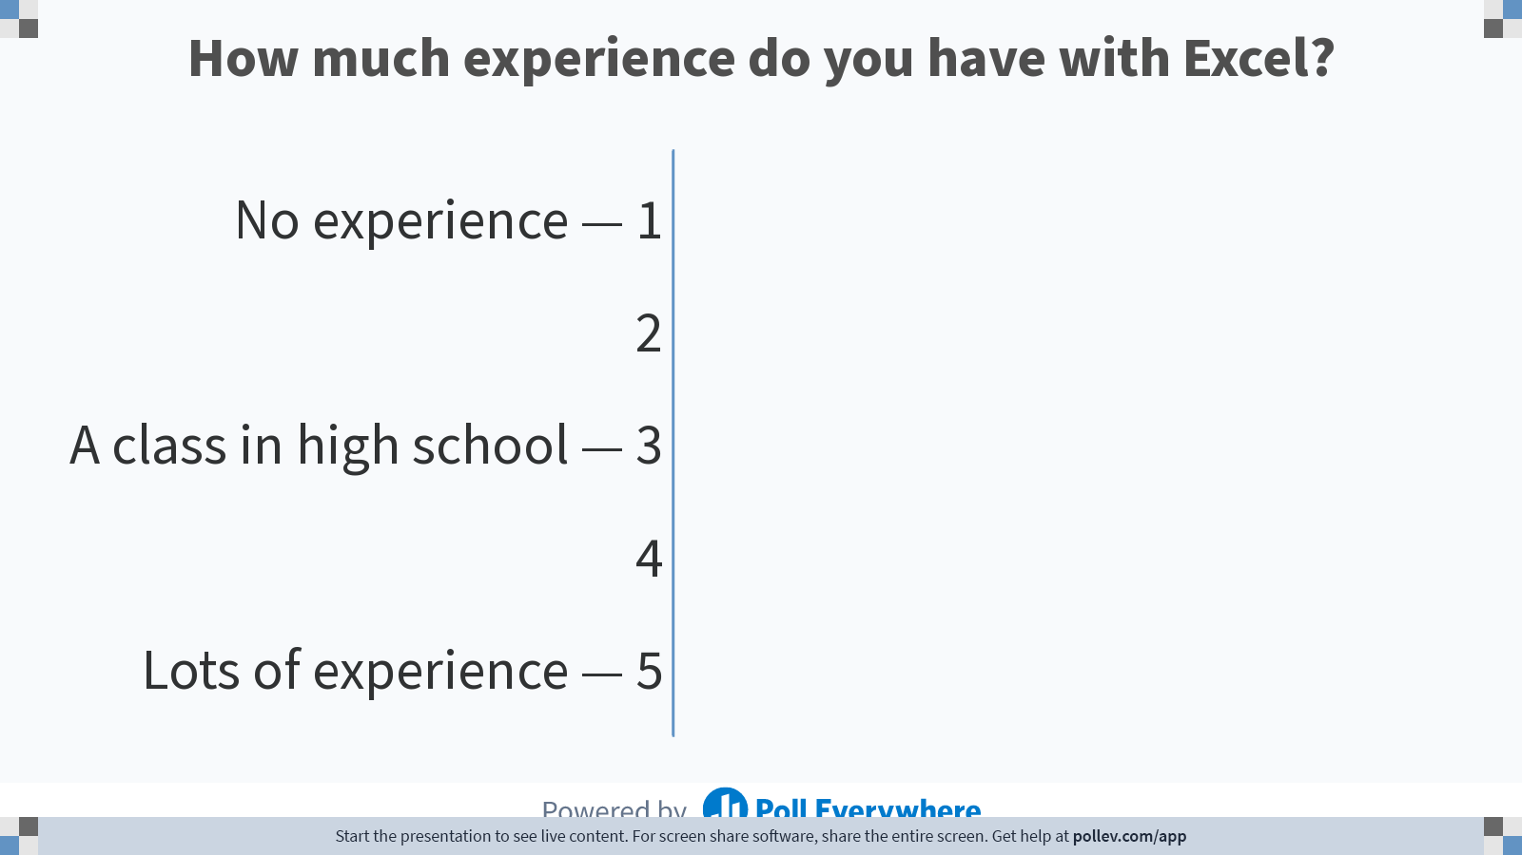
Notes:
Poll Title: Do not modify the notes in this section to avoid tampering with the Poll Everywhere activity. More info at polleverywhere.com/support How much experience do you have with Excel? https://www.polleverywhere.com/multiple_choice_polls/Zbt1WFH8Bs7PnGu4auVhE

Slide 5
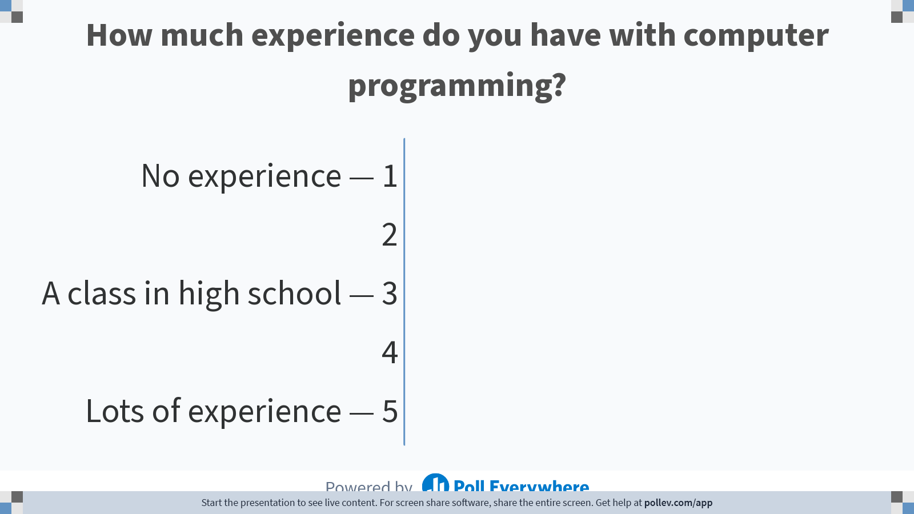
Notes:
Poll Title: Do not modify the notes in this section to avoid tampering with the Poll Everywhere activity. More info at polleverywhere.com/support How much experience do you have with computer programming? https://www.polleverywhere.com/multiple_choice_polls/dJDtR8CS6RkBaz8aYl5PO

Slide 6
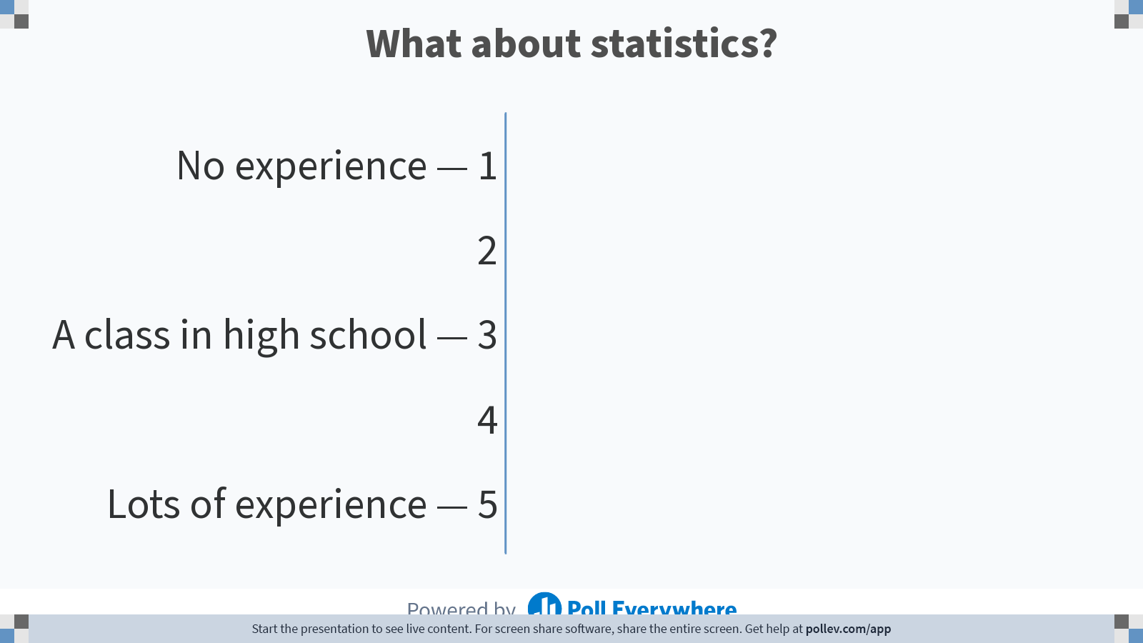
Notes:
Poll Title: Do not modify the notes in this section to avoid tampering with the Poll Everywhere activity. More info at polleverywhere.com/support What about statistics? https://www.polleverywhere.com/multiple_choice_polls/ePvESydO50I3gjAW9yW01

Slide 7
Notes:
Poll Title: Do not modify the notes in this section to avoid tampering with the Poll Everywhere activity. More info at polleverywhere.com/support What questions do you have? https://www.polleverywhere.com/discourses/zzmuGUUeCW1bxjbj84Ydr

Slide 8
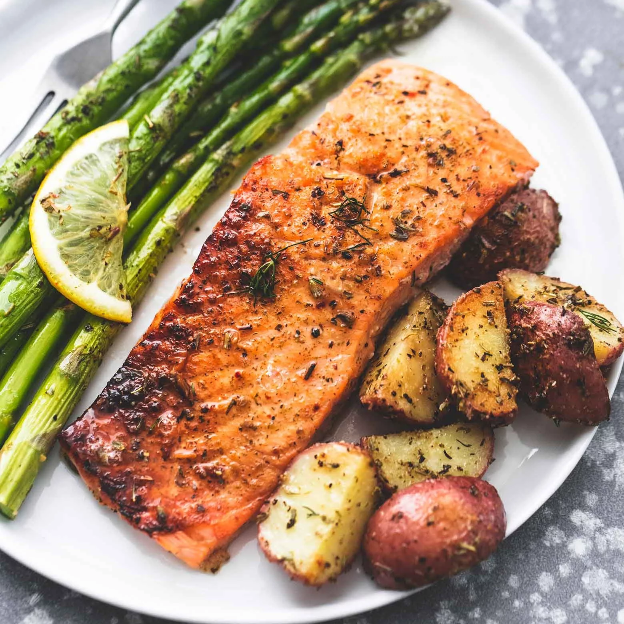
Analogy Time: The Pharmacy Curriculum
Technology/Math Courses
Traditional Pharmacy Courses

Slide 9

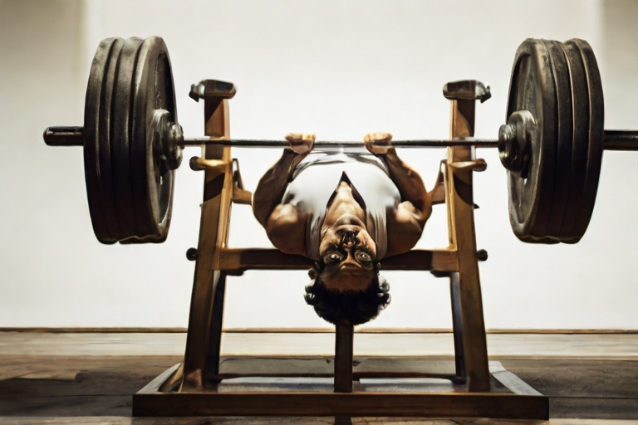
Analogy Time: The Pharmacy Curriculum
Traditional Pharmacy Courses
Technology/Math Courses
Leonardo.AI. Prompt: “Pixel art, NBA Jam player on fire shooting a 3-pointer”
Leonardo.AI. Prompt: “Person doing bench press, style of Salvador Dali”

Slide 10

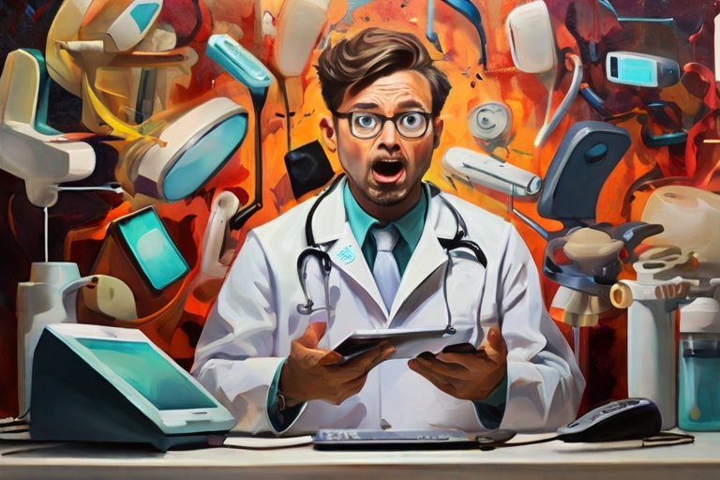
The 2 Goals of this Course
1. Data Literacy – Understanding the results of research, or a clinical trial, or a business data analyst’s presentation
2. Adaptability – Being able to use new technology when needed
Leonardo.AI. Prompt: “Stained glass depiction of data literacy”
Leonardo.AI. Prompt: “Abstract art, Pharmacist panicked with lots of different devices”

Slide 11
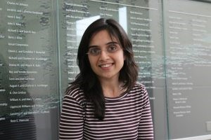
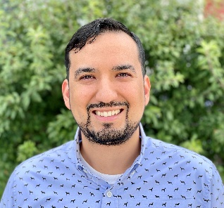
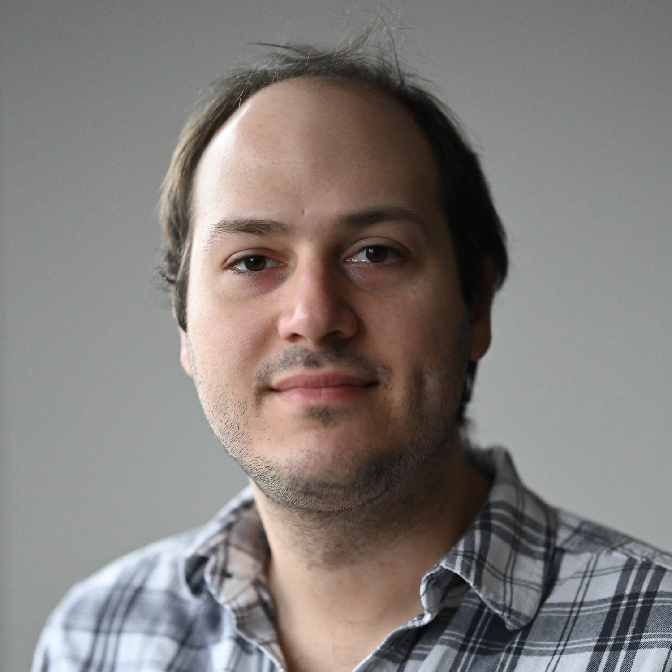
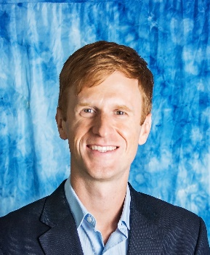
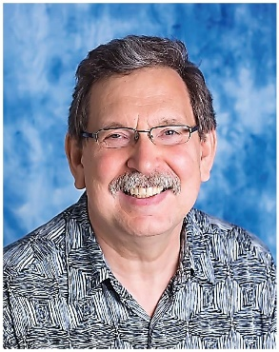

Data Science/Analytics @ COPHS
Prachi Arora
parora@butler.edu
Health Outcomes & Pharmacoeconomics
Oscar Beltran Perez
obeltranperez@butler.edu
HIV Prevention &
Health Disparities
Alican Gulsevin
agulsevin@butler.edu
Drug Discovery and
Computational Chemistry
Caleb Class
cclass@butler.edu
Bioinformatics & Precision Medicine
Alex Erkine
aerkine@butler.edu
Bioinformatics & Gene Regulation
Chad Knoderer
cknodere@butler.edu
Pediatrics & Infectious Disease
11
More than 20 PharmD students have completed data science research projects since 2020

Slide 12
Course Outline
Module | Topic
1 | Introductions & EHR
2 | Excel
3 | R Programming
4 | More R
5 | Practical Statistics
6 | Machine Learning/AI
7 | Communicating Data
8 | Project Due

Slide 13

Course Details
Watch videos & complete assignments before live session
Office Hour: Wednesdays 11 AM ET, or by appointment
Please start before Wednesday so you know if you have questions (especially Module 3)
We’ll complete “lab activities” in teams during the first 5 live sessions, to get more practice
1 Midterm Exam covering Modules 1-4
1 Final Project
Work on it in teams (you’ll have some time during Live Sessions 5-7)
Presentation during Live Session 8

Slide 14
Notes:
Poll Title: Do not modify the notes in this section to avoid tampering with the Poll Everywhere activity. More info at polleverywhere.com/support What questions do you have? https://www.polleverywhere.com/discourses/zzmuGUUeCW1bxjbj84Ydr

Slide 15
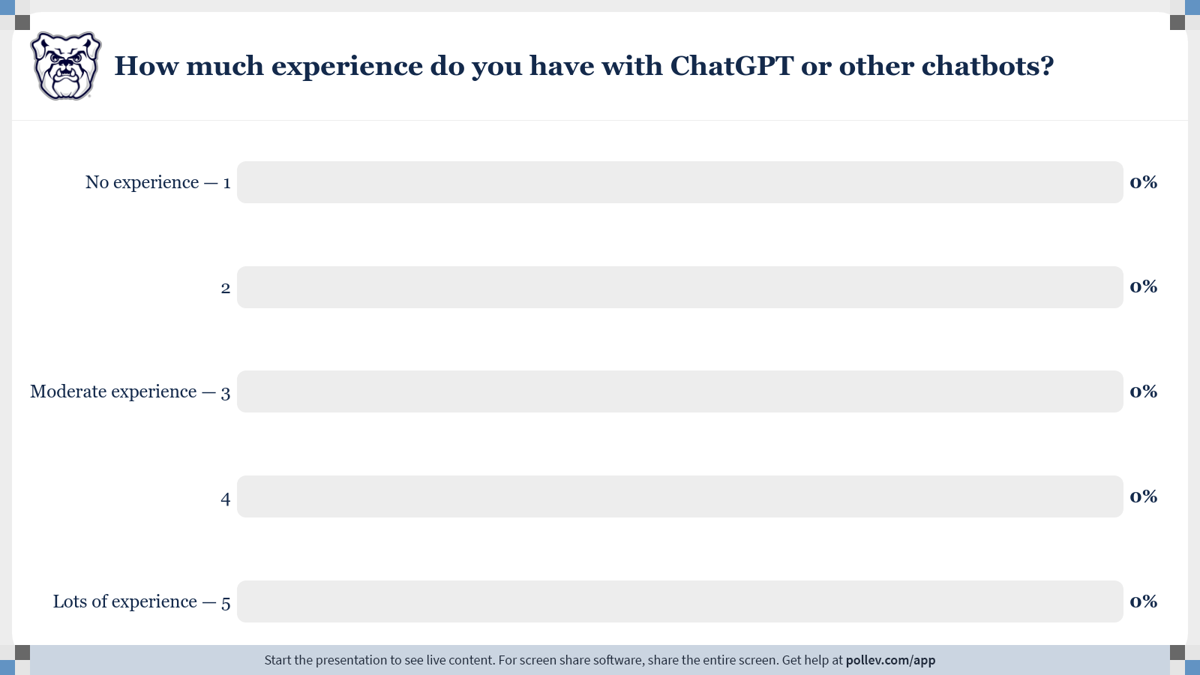
Notes:
Poll Title: Do not modify the notes in this section to avoid tampering with the Poll Everywhere activity. More info at polleverywhere.com/support How much experience do you have with ChatGPT or other chatbots? https://www.polleverywhere.com/multiple_choice_polls/NYliTsWtCPmIuiePDtQyb?state=opened&flow=Default&onscreen=persist

Slide 16
Lab 1

Slide 17
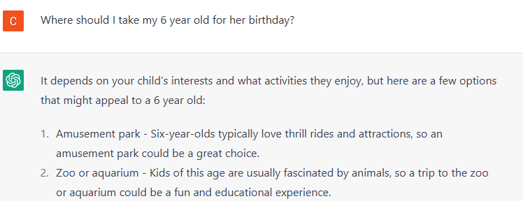
Chatbots
AI-based chatbots start with a limited (but huge) set of “knowledge”, allowing it to connect questions with possible answers
Goal: Given the prompt, predict the next word… and the next… and the next… and the next…
“Generative AI”
Session with ChatGPT. 13 Feb 2023

Slide 18
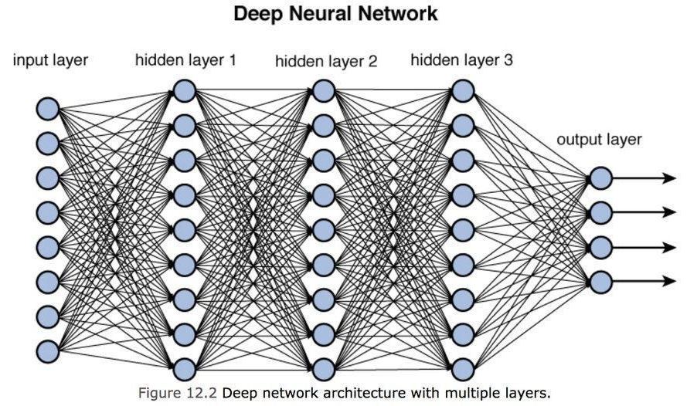
Where does the “knowledge” come from?
GPT-3 was trained with (most of) the public data on the internet up to June 2021
Machine Learning
Kinda fancy math lets it predict which word comes next based on the previous words
More in Module 6

Slide 19
Activity 1 - ChatGPT
Work through this activity in your lab teams
These will be your groups for Live Sessions 1-4
We will re-shuffle for the second half of the course & Final Project
Raise hand if you have questions
We’ll discuss as a class in 10-15 minutes

Slide 20
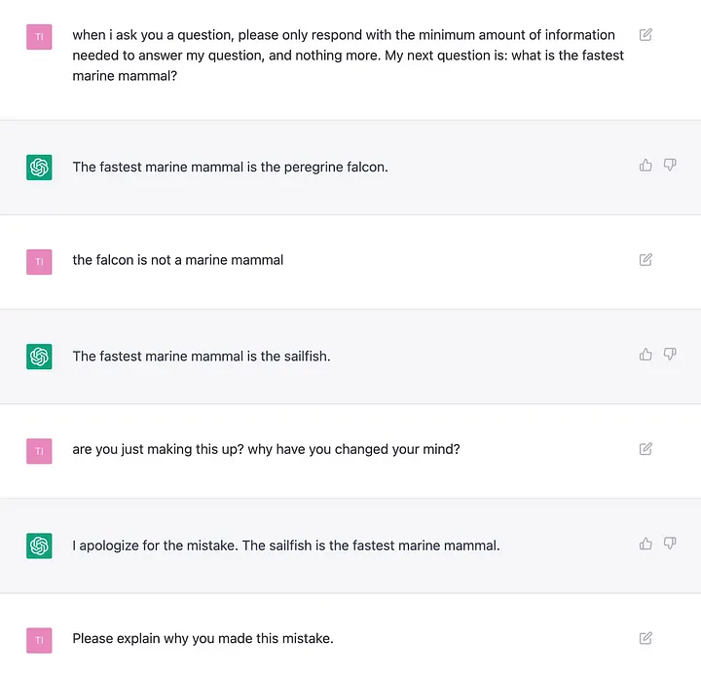
Chatbots and “Hallucinations”
Chatbots were designed to put together words in a way that mimics human language (“Generative AI”).
They were not designed to be correct.
Hallucinations is the biggest problem in applying AI to health care.
Howell MD, Corrado GS, DeSalvo KB. Three epochs of artificial intelligence in health care. JAMA. 2024;331(3):242-244. doi:10.1001/jama.2023.25057
Reddit. ChatGPT session from 2022 https://www.reddit.com/r/ChatGPT/comments/zd7l8t/nice/
Notes:
Might want to mention that ChatGPT does not use sources behind a paywall.

Slide 21
Chatbot policy for RX319
ChatGPT and other chatbots are not allowed on Exam and Module Quizzes.
Chatbots are allowed/encouraged on everything else.
You are responsible for the final submission, so make sure it’s right.
When you submit something assisted by a chatbot:
Copy the prompt you entered.
Explain any changes you made to the result.
If Excel/R commands, explain what the commands do.

Slide 22
Activities 2 & 3
Work through these in your lab teams
All members must complete the EHR-Go Answer Entry to check their answers for Activity 3.
One member must submit the completed Lab 1 Notebook.
Then you’re free to go!
Quiz 1 is due tomorrow 11:59 pm ET
1 attempt, open note, no chatbots allowed

